Slide 1
Town of Tuxedo
LED Street Lighting Proposal
Town Board of Trustees Meeting
May 13th, 2019

Slide 2
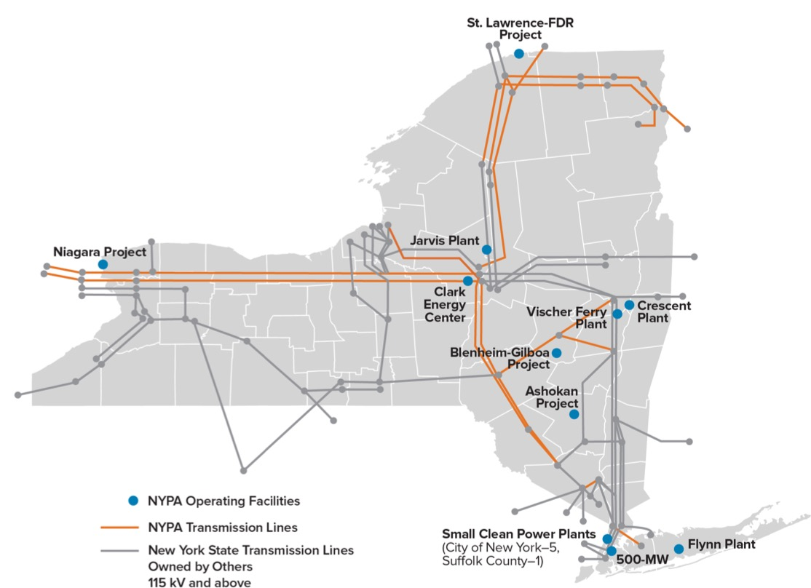
New York Power Authority (NYPA) Quick Facts
  20% of NY’s electricity generation-70%renewable
  1/3 of NY’s transmission backbone
  $300M+ in annual energy efficiency project
  implementation and mgmt.
  No taxpayer support
  Local government, state
  agencies, C&I, nonprofit
  hospitals and universities
Source: New York State DPS REV website
Notes:
Richard Flynn 135MW plant in Holtsville

Slide 3
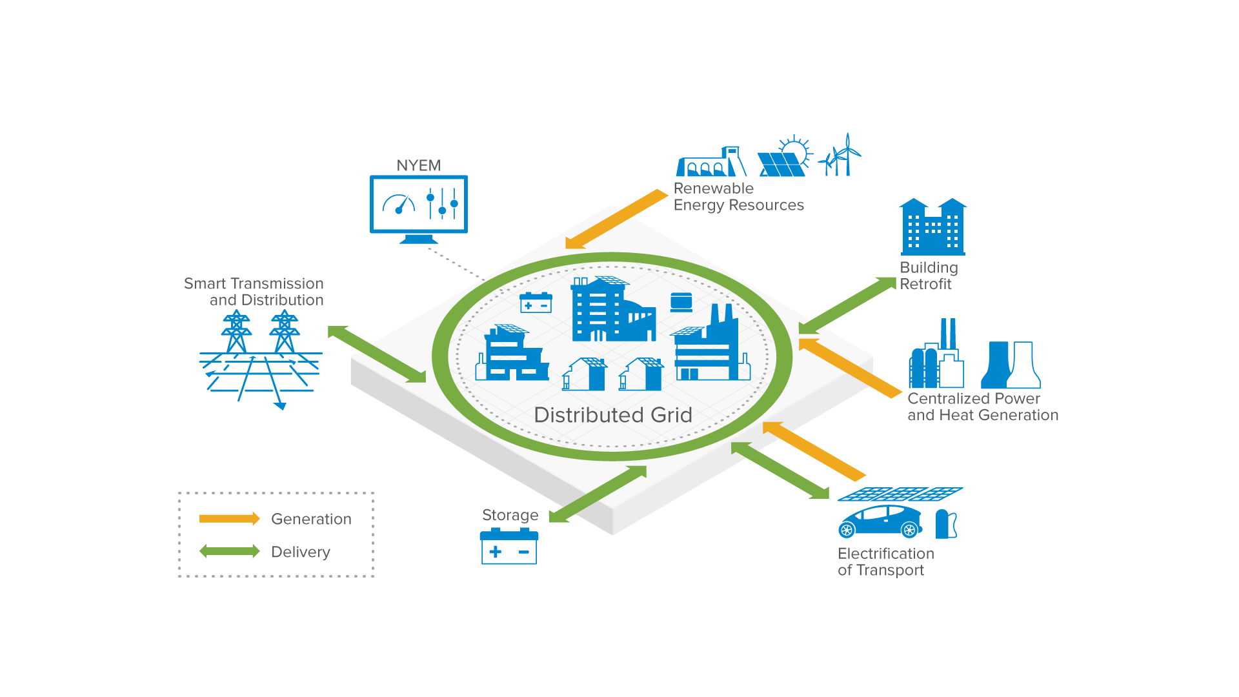



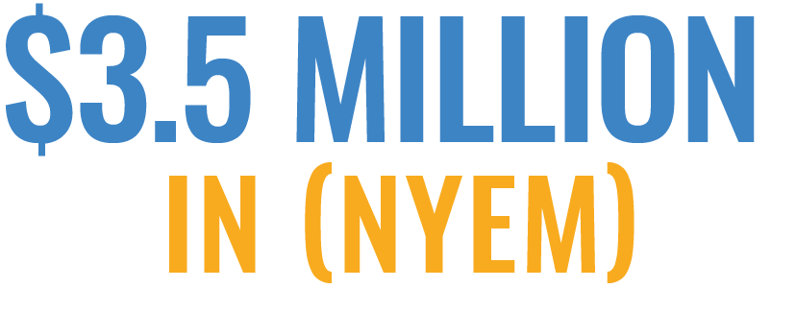
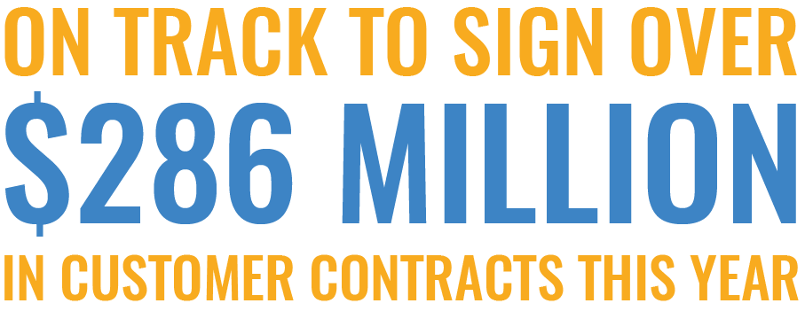
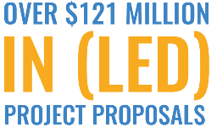



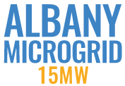

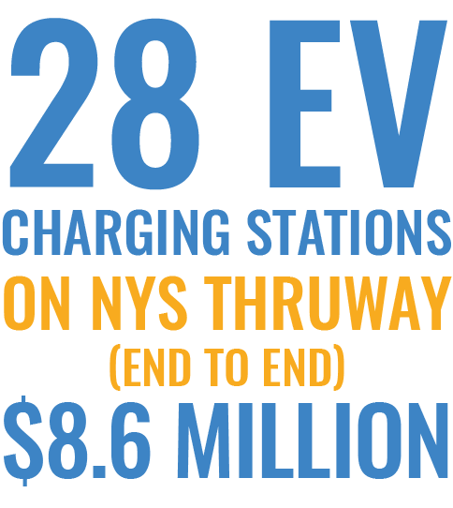
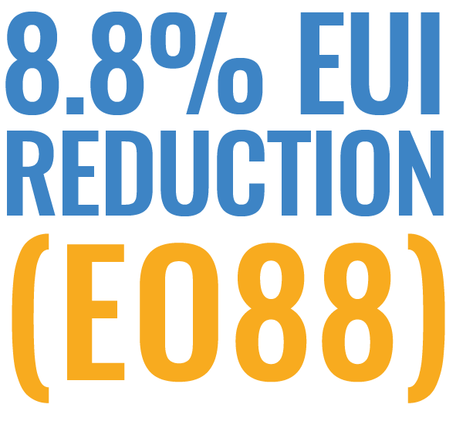
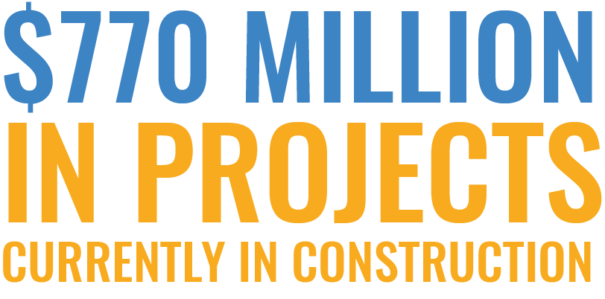
NYPA’s Energy Services Business

Slide 4
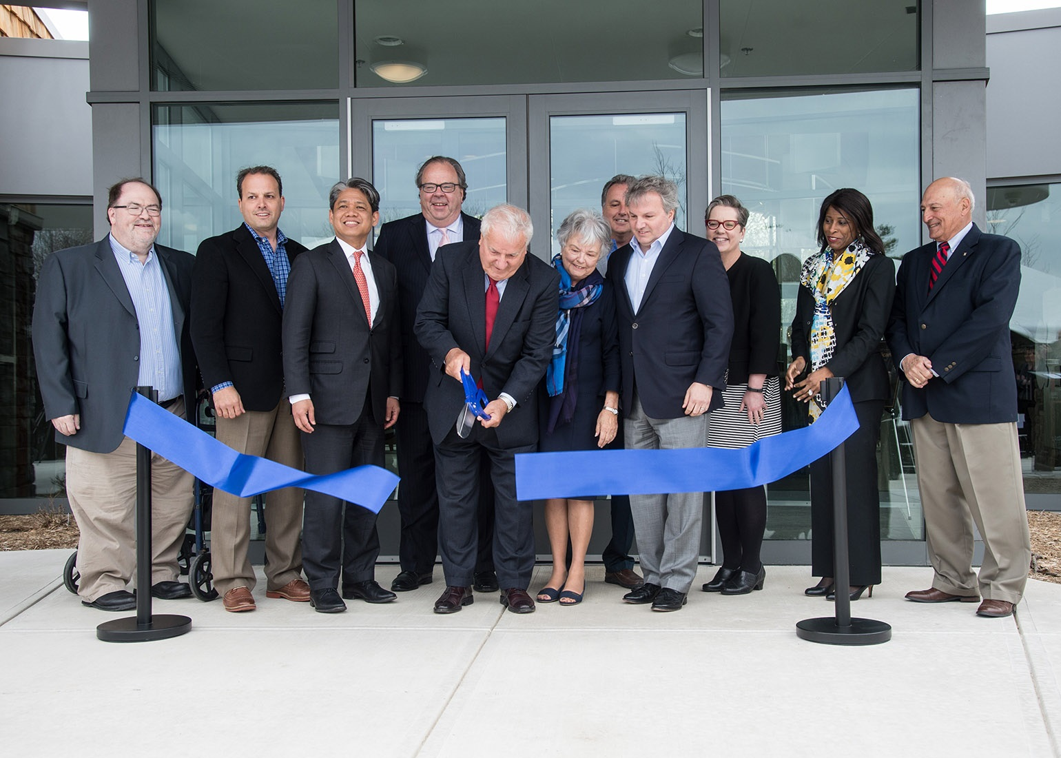

Why Municipalities Can Work with NYPA
Public Authority’s Law (PAL) 1005 (17) authorizes NYPA to finance and design, develop, construct, implement, provide and administer energy-related projects, programs and services for:
Any public entity-Villages, Towns, Cities, Counties
Any not-for-profit institute of higher education within NYS
Any public or nonpublic elementary or secondary school
Any recipient of NYPA’s economic development power programs

Slide 5
Smart Street Lighting NY
  Governor announced that NYPA will implement
  Smart Street Lighting NY Program in January 2018
  NYPA to serve as project implementer for local Govt’s
  Goal of 500,000 street light conversions to LED by 2025
  Over 300,000 lights in pipeline
  Significant savings annually to NYS taxpayers
  Reduced energy consumption equal to 44,770 NYS households
  Improved quality of light, resident comfort and safety for communities across the state

Slide 6
NYPA’s Full Turn-key Street Light Service
Implementation:
Design Engineer of Record, Procurement, Financing
Enhancements: Smart City Solutions
Service:
Street Light Operations and Maintenance

Slide 7
NYPA Conversion of Street Lighting System
    PROJECT FINANCING
NYPA offers competitive low-cost financing, including financing during construction. NYPA will finance all up-front development and project milestone costs. No out of pocket costs to the municipality
No repayment to NYPA until project is
100% complete
Notes:
Add this into conversion

Slide 8
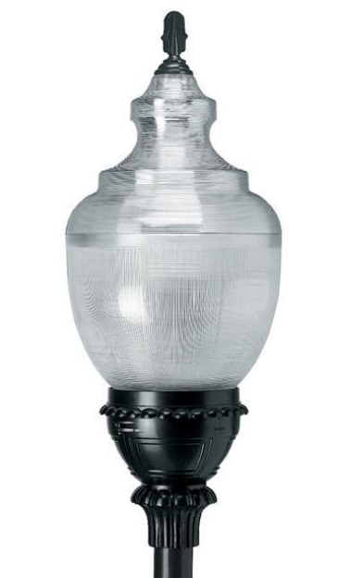
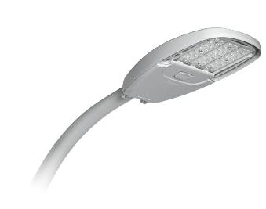
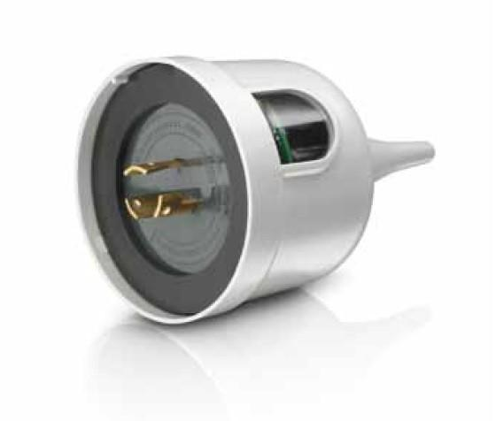
NYPA Conversion of Street Lighting System
Aggregated materials procurement
NYPA implemented a nation-wide competitive material bid
Options include:
    Color temperatures
    Beam spreads
    Wattages
    Controls
    Decorative luminaires
Municipalities will receive materials ~30% below market costs
Notes:
Focus on the outcome, superior pricing

Slide 9
Key Street Lighting Projects To Date
Pipeline of over 200 projects and over 300k fixtures in development
Municipality | # of fixtures | Status
Town of Clarkstown | 3,900 | Completed
Village of Glen Cove | 498 | Design
City of White Plains | 3,800 | Completed
Town of Southampton | 2,300 | Completed
Village of S. Nyack | 190 | Design
Village of Cedarhurst | 794 | Design
Village of Kings Point | 200 | Design
City of Kingston | 2,428 | Design
Town of Ramapo | 1,396 | Design
Notes:
Local contractors will be bidding, MWBE requirements

Slide 10

Smart City Solutions
    ENVIRONMENTAL
    Outdoor air quality monitoring
    Ice / snow detection
    Weather
    PUBLIC SAFETY
    Video / camera technology
    Noise / motion monitoring
    TRANSPORTATION
    Public transportation benefits
    Optimization / monitoring
    Parking management
    Connected vehicles
Notes:
Improve services for residents, businesses, employees, and visitors
Customize solution, each municipality has different goals and needs
Improved customer experience, resident comfort and economic development
Enhances the effectiveness and efficiency of municipal operations

Slide 11
  NYPA Proposal Overview—217 Total Fixtures
Turnkey cost estimate including contingency: $111,682
Estimated annual energy cost savings: $7,432
Estimated Street lighting maintenance cost savings: $12,810
Project simple payback term: 8.13 Years (includes purchase of existing fixture inventory from O&R)
NYPA financing for 10 years = $715 annual positive project cash flow
Notes:
Instant notification, proactive approach, no more calls, instantaneous info. Better service for residents. Tied into maintenance contracts

Slide 12
Charge NY 2.0
Initiative to accelerate the growth of the EV market in New York
  Collaboration between NYPA, NYSERDA, and NYS DEC
  Goal of reaching 10,000 charging stations by 2021
  Charge NY 1.0 was launched in 2013 with goal of 3,000 charging stations across NY by 2018.
    Goal was met with 3000+ charging stations installed by EOY 2018

Slide 13
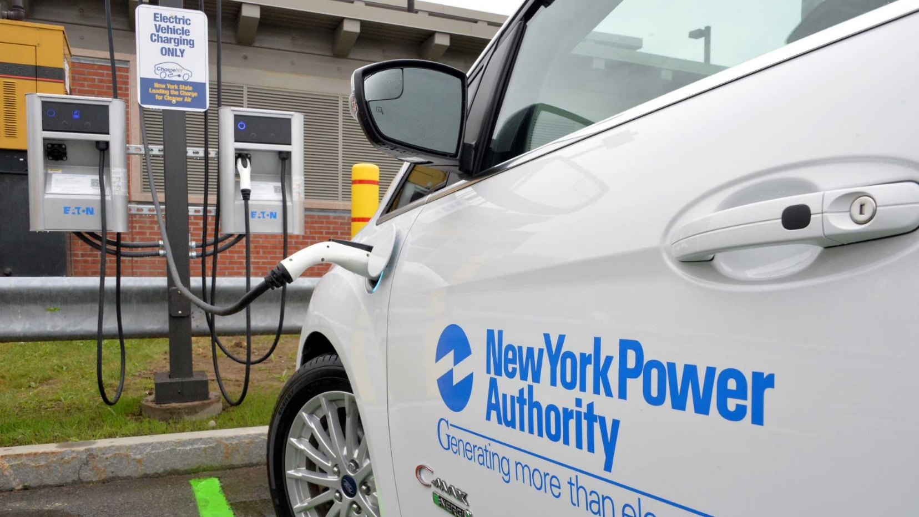
Why NYPA?
Experience
  Over 20 years in electric transportation
    Testing early prototype EVs
    Collaborated with MTA on initial deployment of hybrid buses
    Developing technical standards for charging equipment
    Airport ground support electrification
    Early deployments of public charging stations
      Largest open protocol deployment in North America
Ability
  Staff skilled to implement EVSE projects
Policy
  NYPA is part of the Governor’s Charge NY team along with DEC and NYSERDA
Notes:
John will provide slide or show location of it on (1/18/2019)

Slide 14
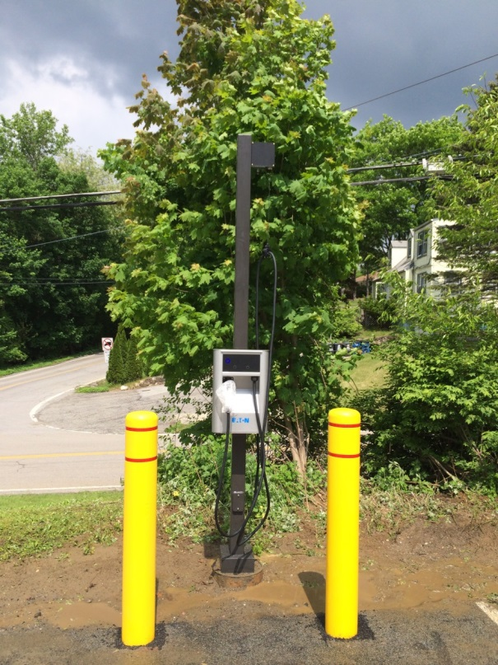
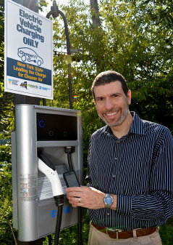
Typical L2 Public Charging Installation
Cable
management
system
Cable
holster
Bollards
Network access
Notes:
Personnel protection, payment interface, disconnect relay. Charger is actually in car.
For DCFCs- unit is charger.
Add label- Typical EV Charger Guy

Slide 15
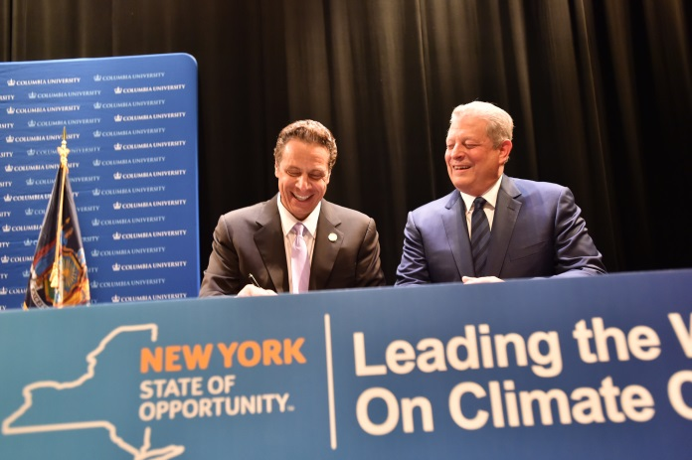
Relevant State Policies
Zero Emission Vehicle (ZEV) Mandate
  850,000 plug-in vehicles in New York by 2025
Carbon Reduction
  40% by 2030 and 80% by 2050
  Transportation: accounts for 40% of carbon emissions in NY is growing, while electricity carbon intensity is shrinking
Renewable generation
  70% of all supply by 2030, 100% by 2040
  Nearly double the current percentage
  Currently it is largely NYPA hydro, but solar and wind will make up most of the difference
Notes:
Update the new renewables target, look into the 2019 SoTS from January. (1/18/2019)

Slide 16
NYSERDA - Charge Ready NY
Open to both public and private organizations to install Level 2 EV charging stations
  At public parking facilities, workplaces, and multifamily apartment buildings
Rebates of up to $4,000 per charging port installed.

Slide 17
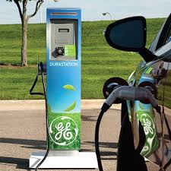
DEC Rebate Program - Charging Stations
Third window of funding will be announced in Q1 of 2019
Must be accessible to the general public
Covers 80% to 100% percent of costs
  Full install or self-install (labor counts as cost share)
Cap per facility: $250,000
Cap per municipality: $625,000
Must be networked EVSE
Can be level 2 or level 3 EVSE
Rebate caps per port:
  Level 2: $8,000
  Level 3: $32,000

Slide 18
EV Charging Station Project Estimate
Install 2 Level 2 EV charging Stations, each with 2 ports- 1 At Metro North Parking Lot and 1 at the Commuter Parking Lot
Turnkey Project Cost- Not to exceed $87,589
Equipment Type- Broadband Telecom Power
NYPA has procured materials and installation labor allowing for an expedited project completion timeline
Pricing includes allowances for additional features including signage, wheelstops, ballards, environmental testing, and a 15 % contingency allowance

Slide 19
Next Steps in
Sign the Master Cost recovery Agreement- general terms and conditions, fee schedule
Sign a Customer Project Commitment which will initiate materials order
Set up project kick off meeting to set timelines and point of contact

Slide 20
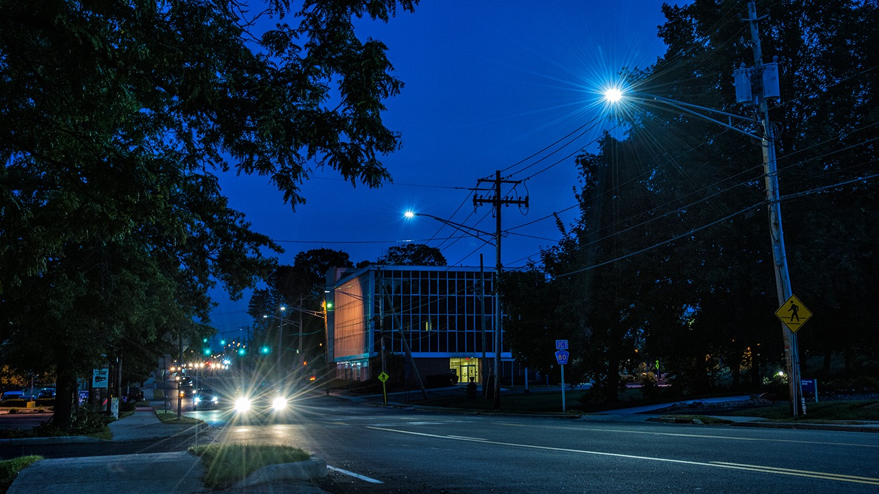
Questions?
Jesse Scott
Customer Business Development
Jesse.Scott@nypa.gov

